Slide 1
Creating Space Through Mindfulness and Meditation
Confessions of an Overreactor
John Shinner – November 17, 2015

Slide 2
Overreact verb
Respond more emotionally or forcibly than is justified
http://www.oxforddictionaries.com/

Slide 3
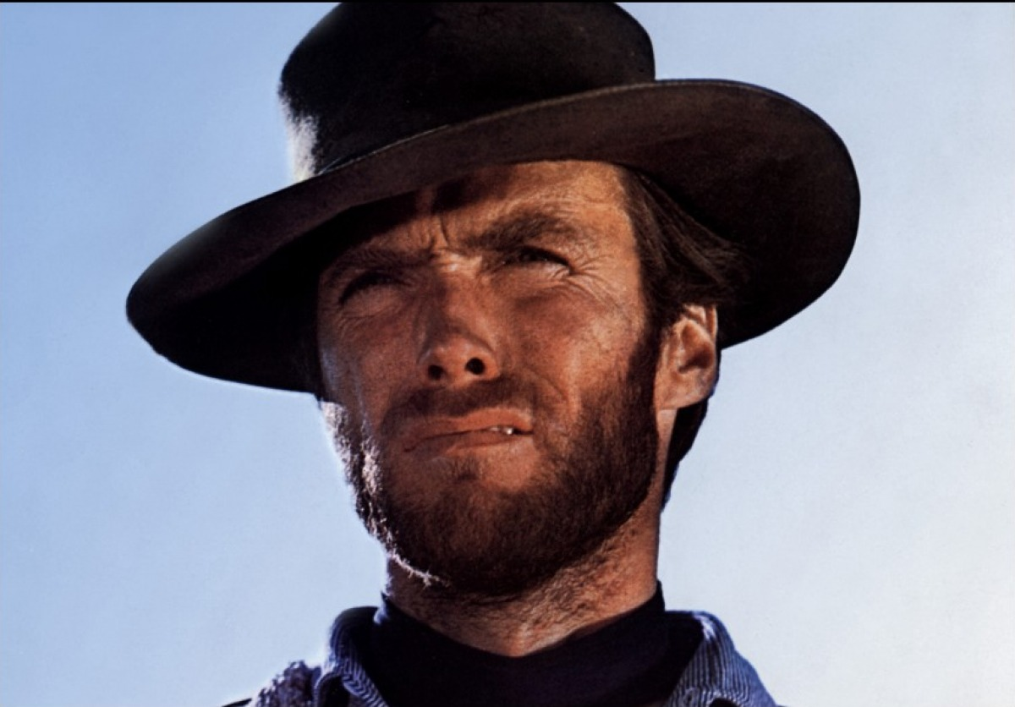

Slide 4
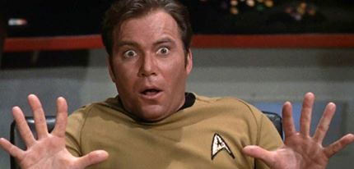

Slide 5
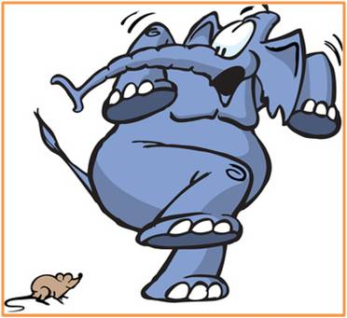

Slide 6


Slide 7


Slide 8
“Between stimulus and response there is a space. In that space is our power to choose our response. In our response lies our growth and our freedom.”
Victor Frankl , Man’s Search for Meaning

Slide 9
The Conference Obligatory 3 Things
Build Muscle Memory
Every Day
When All is Said and Done

Slide 10
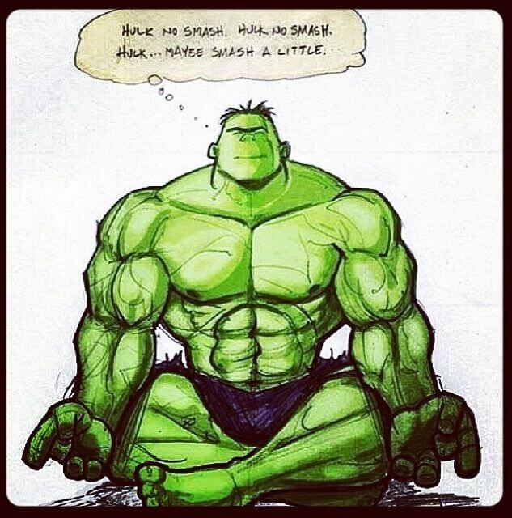

Slide 11
“Meditation is the only intentional, systematic human activity which at bottom is about not trying to improve yourself or get anywhere else, but simply to realize where you already are.”
Jon Kabat-Zinn, Wherever You Go, There You Are

Slide 12
“Emotional self-control-- delaying gratification and stifling impulsiveness- underlies accomplishment of every sort”
Daniel Goleman, Emotional Intelligence: Why It Can Matter More Than IQ

Slide 13
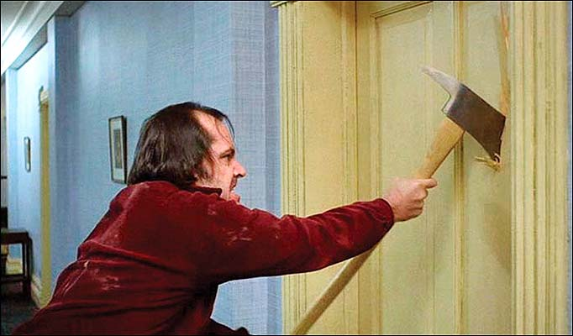

Slide 14
She sells sea-shells on the sea-shore. The shells she sells are sea-shells, I'm sure. For if she sells sea-shells on the sea-shore Then I'm sure she sells sea-shore shells.

Slide 15
“In the beginner’s mind there are many possibilities, but in the expert’s there are few.”
“The goal of practice is always to keep our beginner’s mind.”
Shunryu Suzuki, Zen Mind, Beginner's Mind

